Slide 1
Statistical Consulting
Baohua Wu
Biostatistics & Bioinformatics Department

Slide 2
What does the statistician need to know about your study?
Background
Status
Aims/Objectives/Hypotheses
What help needed?
When is it needed by?

Slide 3
Topics
Prepare a study: Study goal/Hypothesis testing/Study design/Sample size & Power Analysis.
Database construction and cleaning: CRF development/Data collection/Data management (Data cleaning/Data manipulation).
Routinely used statistical methods (groups comparison/correlation/longitudinal data analysis etc).
Preparation and Interpretation of statistical report (Tables/Graphs on request).
Statistical writing support (grant proposals/manuscripts/presentation), and follow up.

Slide 4
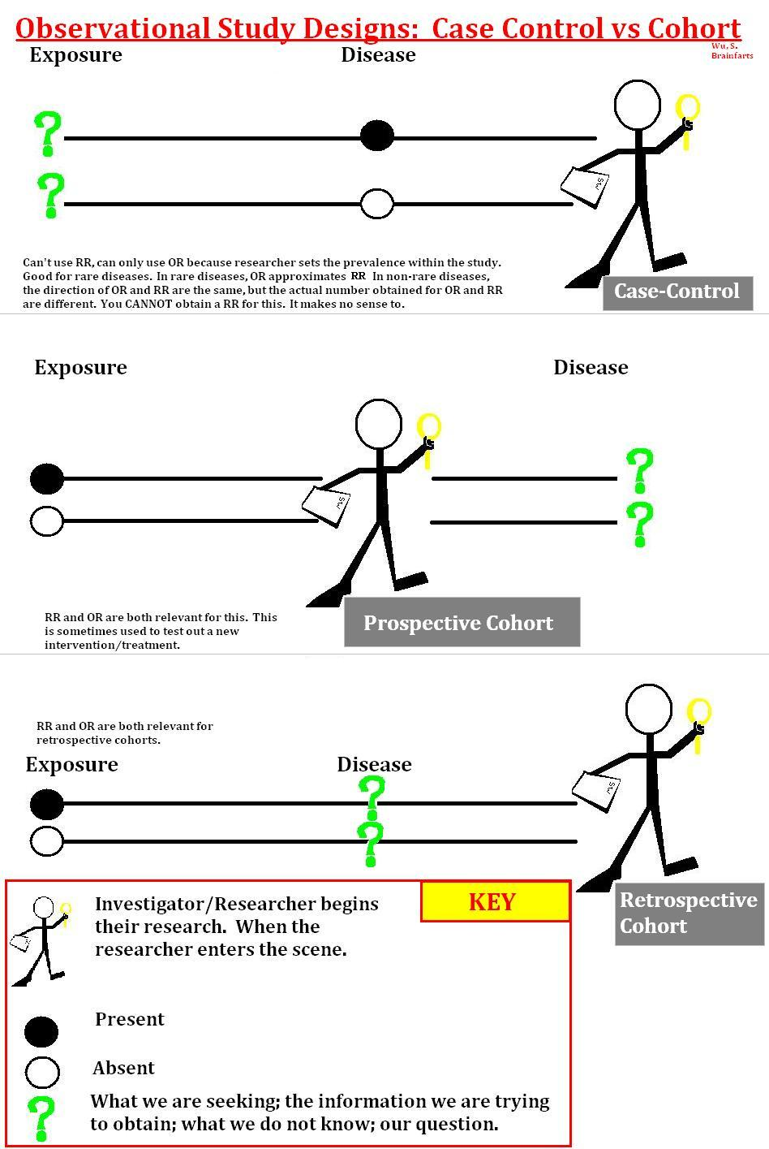
Study Design
measure of health that the intervention is supposed to affect
Input
Medical Study
Intervention
Exposure
Output
Cohort Study
  prospective cohort study
  retrospective cohort study
Case control study
Cross-sectional study
Longitudinal study

Slide 5
Sample Size/Power Analysis
Sample Size
  Too small → not be able to answer the posted questions.
  Too big → resources wasted
sample size depends on four critical quantities:
Type I and Type II error rates α and β, the variability of the data σ², and the effect size d.
Usually α and β are fixed at 5% and 20% (or 10%), respectively.

Slide 6
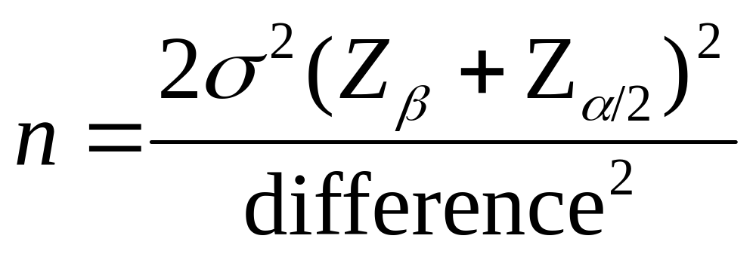
Formula for Difference in Means
Represents the desired power (typically .84 for 80% power).
Sample size in each group (assumes equal sized groups)
Represents the desired level of statistical significance (typically 1.96).
Standard deviation of the outcome variable
Effect Size (the difference in means)

Slide 7
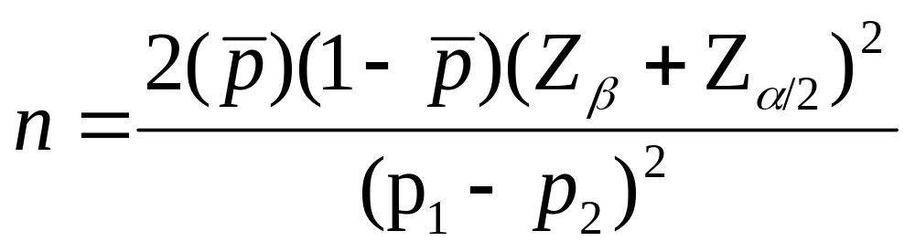
Formula for Difference in Proportions
Represents the desired power (typically .84 for 80% power).
Sample size in each group (assumes equal sized groups)
Represents the desired level of statistical significance (typically 1.96).
A measure of variability (similar to standard deviation)
Effect Size (the difference in proportions)

Slide 8
Data management
Case Report Form/ Database Design
Data Collection
Data Entry/Data Validation/Data Queries
Data Cleaning/Data Manipulation
  Data format need to be consistent,
  Date/Time: Keep in date/Time format in Excel. let me do the data manipulation, such as for “Length of Stay”, I will compute it by “End-Start”, not you, unless you need.
  Character variables are better to be coded as number, such as for gender, 0=“Female” and 1=“Male”.
  Otherwise keep the consistency for you best, such as for “Yes/No”. Bad Entry: “Yes/yes/Y/y”!
  Deal with missing:

Slide 9
Choosing A Statistical Test
What is the main study hypothesis?
Are the data independent?
A rule of thumb: results on the same individual, or from matched individuals, are not independent
What types of data are being measured?

Slide 10
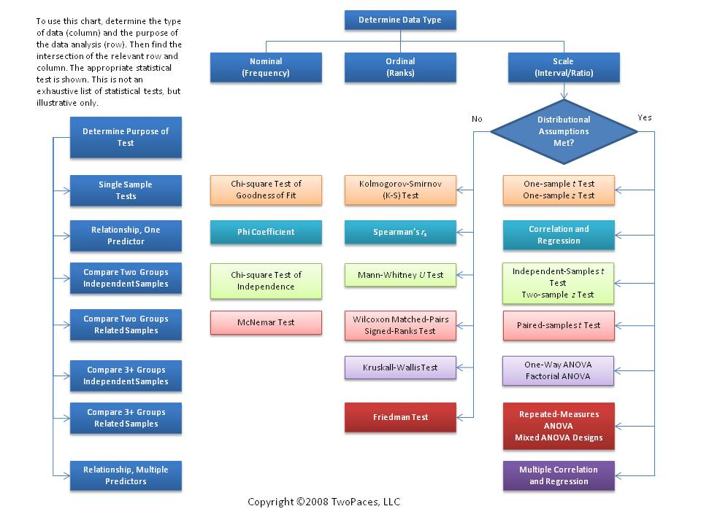

Slide 11


Inter-rater reliability(Kappa statistics)
  Cohen's kappa,
  Fleiss' kappa
 | Interpretation
< 0 | Poor agreement
0.01 – 0.20 | Slight agreement
0.21 – 0.40 | Fair agreement
0.41 – 0.60 | Moderate agreement
0.61 – 0.80 | Substantial agreement
0.81 – 1.00 | Almost perfect agreement

Slide 12
Statistical Report
Tables(title/condition/sample size/note etc.)
Graphs(title/axis/legend/symbol/marker/sample size/p value/note etc.)
Interpretations: Why choosing this test/method?
Conclusions: What conclusions could be derived based on the results?

Slide 13
Statistical Writing Support/Follow-Up
Description of study
Sample size
Statistical methods(reason for choosing )
Software/Statistical package used.
Result interpretations/Conclusions.
Reviewer’s questions

Slide 14
Contacting Us
Contact for Consulting as early as possible in a study
Provide as much information as you can
      Baohua Wu
      Department of Biostatistics and Bioinformatics
      1518 Clifton Rd, Room 210(RSPH Building)
      Atlanta, Georgia 30322
      Tel: 404-727-3926
      Email: bwu2@emory.edu

